Slide 1


Fernando Ivan Suarez
September 2023

Slide 2

Outline
Executive Summary
Introduction
Methodology
Results
Conclusion
Appendix

Slide 3
Executive Summary
Summary of methodologies:
Data Collection through Space X’s API and Webscraping Wikipedia.
Data Wrangling.
EDA with SQL (Exploratory Data Analysis)
Visualizating Data with Matplotlib and Seaborn
Interactive Map with Folium.
Training of 4 Machine Learning Models
Summary of all results
Space X has improved within 2013 and 2020.
A model to predict launch success has been discovered with a 95% accuracy.

Slide 4
Introduction
We represent a group of Data Scientists at Space Y,
We need to provide a price depending on the needs of the client’s launch.
A key component of the price depends on the landing of the first stage.
To do so we would like to determine if Space X First Stage will land successfully.
We will build different models to know which one is the best to forecast new launch success.

Slide 5

Section 1

Slide 6
Methodology
Executive Summary
Data collection methodology:
We extract data from Space X API and Webscraping Wikipedia.
Perform data wrangling
In a Dataframe, we build a column to determine the success of the launch.
Perform exploratory data analysis (EDA) using visualization and SQL
Perform interactive visual analytics using Folium and Plotly Dash
Perform predictive analysis using classification models
How to build, tune, evaluate classification models

Slide 7
Data Collection
We needed two datasets, one came from Space X and the other one from Wikipedia.
Space X data was extracted through their API.
Launch records of Falcon 9 were extracted through webscraping Wikipedia.

Slide 8
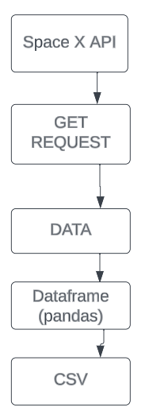
Data Collection – SpaceX API
We used Pandas, Numpy and Requests libraries.
We structured some functions to extract specific information in certain places.
The response was brought to a JSON file.
Next, this JSON became a Dataframe.
Github link: https://github.com/fernandosuarez89/Capstone/blob/main/jupyter-labs-spacex-data-collection-api.ipynb.

Slide 9
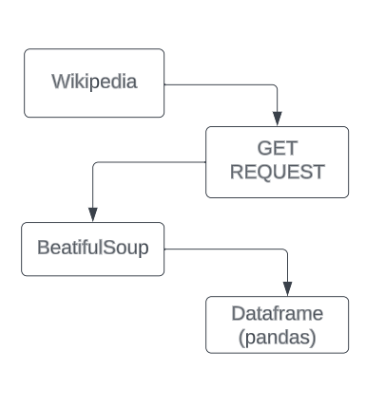
Data Collection - Scraping
Data was collected with beatifulsoup.
Data came from Wikipedia.
Data normalized with our functions.
Data loaded in a Dataframe
GitHub URL: https://github.com/fernandosuarez89/Capstone/blob/main/jupyter-labs-webscraping%20(1).ipynb.

Slide 10
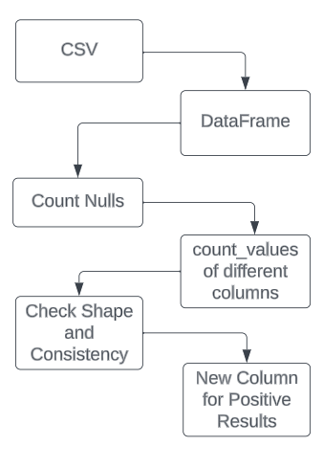
Data Wrangling
We load the data into a Dataframe.
We evaluate different columns distribution.
We included a new column normalizing results into positive and negative only.
Github Link: https://github.com/fernandosuarez89/Capstone/blob/main/IBM-DS0321EN-SkillsNetwork_labs_module_1_L3_labs-jupyter-spacex-data_wrangling_jupyterlite.jupyterlite.ipynb.

Slide 11
EDA with Data Visualization
Yearly trend chart was to show success rate evolution across years.
Payload Mass vs Orbit plot helped us understand which orbits and payload were successful.
Flight Number vs Orbit plot showed that increasing launches improved the success rate.
Success Rate vs Orbit shows which orbits were more successful.
Launch Site vs Payload Mass showed how much mass in each site outcome.
Flight Number vs Launch Site plot showed that increasing launches improved the success rate.
Flight Number vs Payload Mass within more launches Space X increased mass.
GitHub Link: https://github.com/fernandosuarez89/Capstone/blob/main/IBM-DS0321EN-SkillsNetwork_labs_module_2_jupyter-labs-eda-dataviz.ipynb.jupyterlite.ipynb.

Slide 12
EDA with SQL
Show unique launch sites.
Show 5 rows where the launch site began with ‘CCA’.
Display the total payload mass carried by boosters launched by NASA (CRS).
Display average payload mass carried by booster version F9 v1.1.
List the date when the first succesful landing outcome in ground pad was achieved.
Show specific success launches with certain payload.
List the total number of successful and failure mission outcomes.
List the names of the booster_versions which have carried the maximum payload mass.
Show specific failure launches in 2015 using substr function.
Rank the count of landing outcomes between specific dates.
GitHub Link: https://github.com/fernandosuarez89/Capstone/blob/main/jupyter-labs-eda-sql-coursera_sqllite.ipynb.

Slide 13
Build an Interactive Map with Folium
We generated an interactive map marking all launch sites and adding map objects such as circles, markers and lines.
We created those objects to visually check the quantity, location, distance and failure or success of the launches.
GitHub Link: https://github.com/fernandosuarez89/Capstone/blob/main/IBM-DS0321EN-SkillsNetwork_labs_module_3_lab_jupyter_launch_site_location.jupyterlite.ipynb.

Slide 14
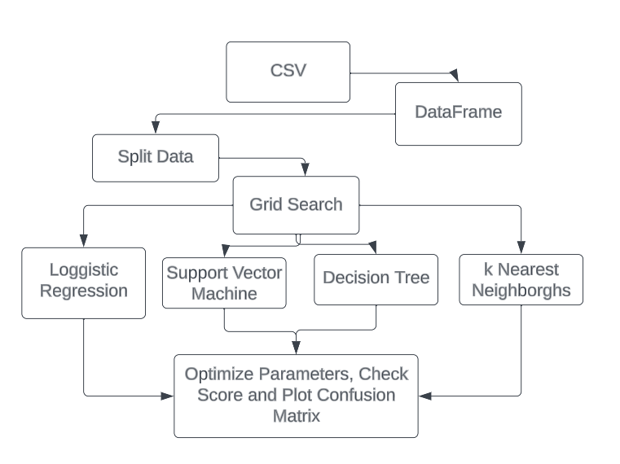
Predictive Analysis (Classification)
We loaded the independent variables into a Y dataset, while we also assigned the X variable to the actual positive and negative values.
We tested 4 different models.
We selected the one that predicted the best which was the decision tree model.
GitHub Link: https://github.com/fernandosuarez89/Capstone/blob/main/IBM-DS0321EN-SkillsNetwork_labs_module_4_SpaceX_Machine_Learning_Prediction_Part_5.jupyterlite.ipynb.

Slide 15
Results
Exploratory data analysis results
Interactive analytics demo in screenshots
Predictive analysis results

Slide 16

Section 2

Slide 17
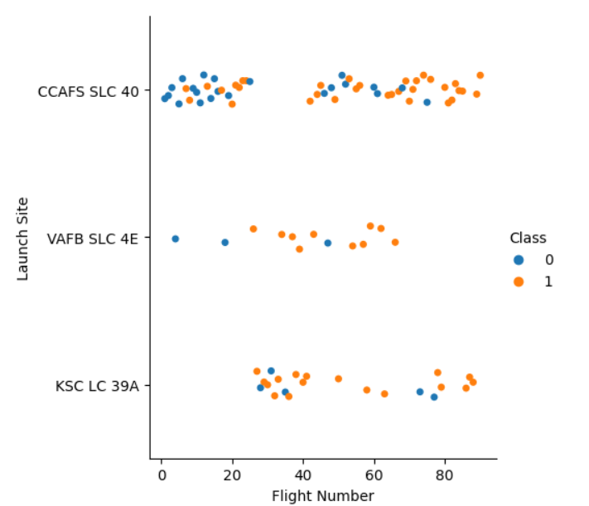
Flight Number vs. Launch Site
From the chart we see that as flights number increase the success rate also increase.

Slide 18
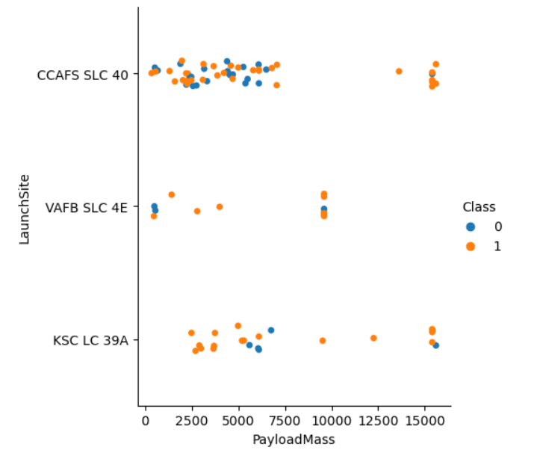
Payload vs. Launch Site
In the CCAFS launch site there are many low weight failures but the heavy ones were successful.
In the VAFB site there are no heavy launches.
KSC launches has a great variance in payload mass and more successful.

Slide 19
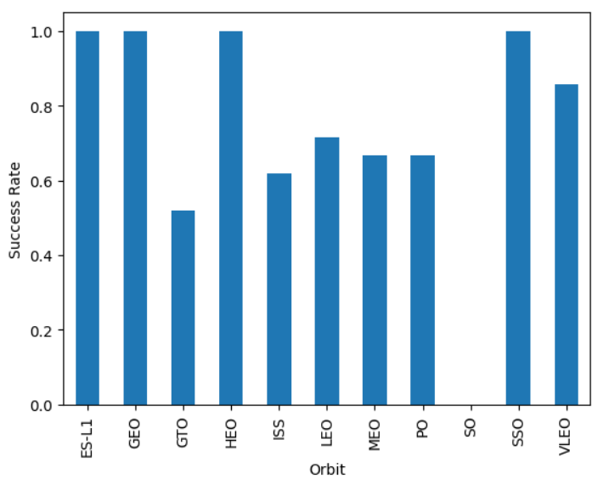
Success Rate vs. Orbit Type
ES-L1, GEO, HEO and SSO has the highest success rate.

Slide 20
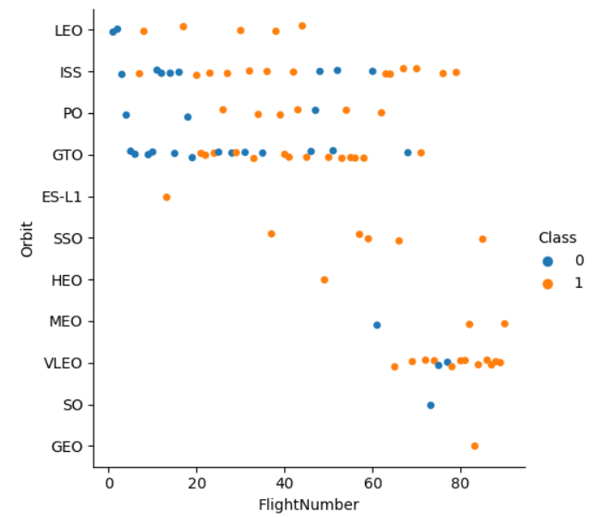
Flight Number vs. Orbit Type
The older launches were performed to LED, ISS, PO and GTO orbits.
Within subsequent launches the orbits turn more successful than at the very begging
ES-LI, HEO, SO and GEO orbits have only one flight, making them unpredictable.

Slide 21
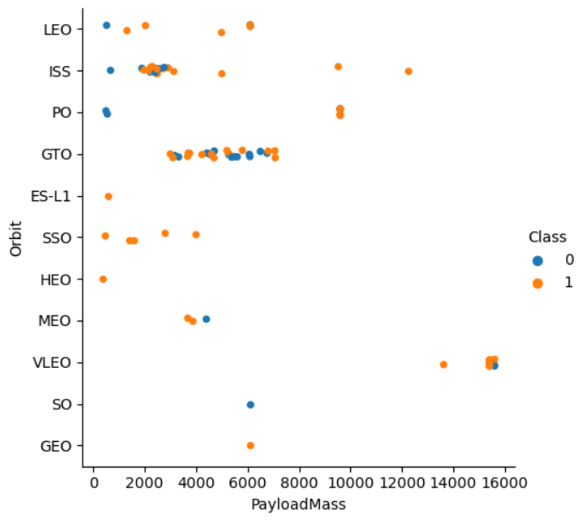
Payload vs. Orbit Type
In GTO we don’t see a clear relationship of successes and failures.
Only just 3 orbits have payloads with more than 8000 kg.

Slide 22
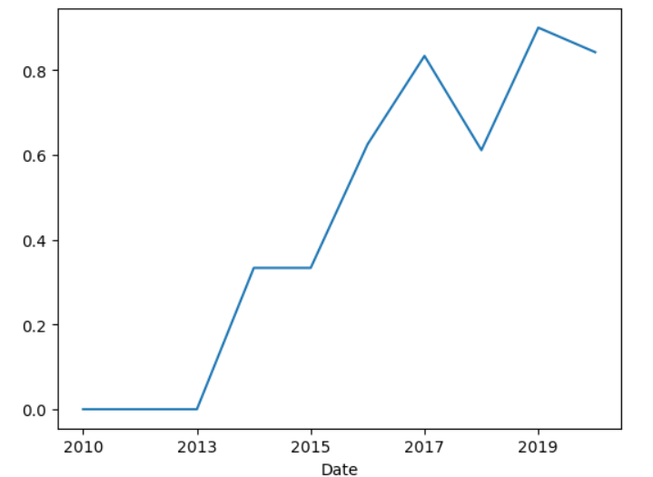
Launch Success Yearly Trend
As Space X launch more flight they had a greater success rate.

Slide 23
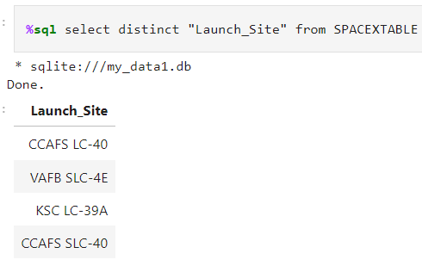
All Launch Site Names
There are only 4 launch sites for Falcon 9

Slide 24
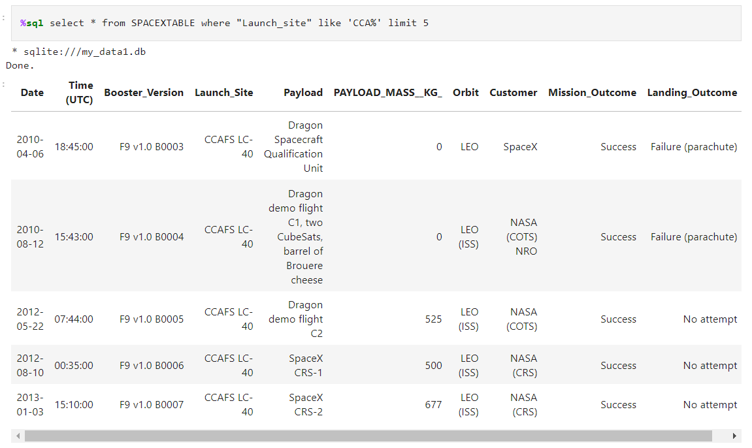
Launch Site Names Begin with 'CCA'
The first 5 records that we found with launch site names beginning with ‘CCA’ are all failures.

Slide 25
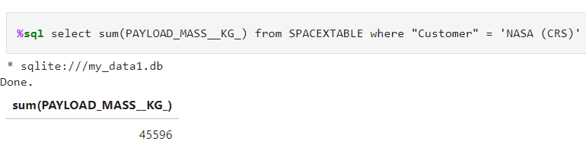
Total Payload Mass
The total payload mass for the customer Nasa (CRS) is 45596kg.

Slide 26
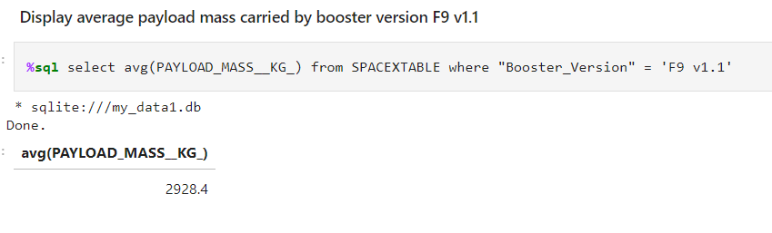
Average Payload Mass by F9 v1.1
The average payload mass of the Booster Version F9 v1.1 is 2,928 kg.

Slide 27
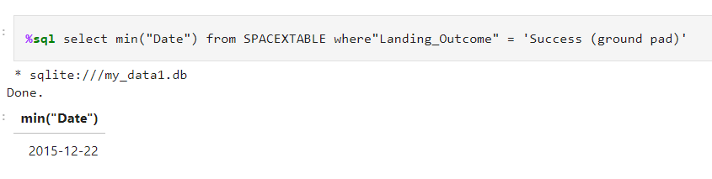
First Successful Ground Landing Date
In December 2015 was the first successful ground landing.

Slide 28
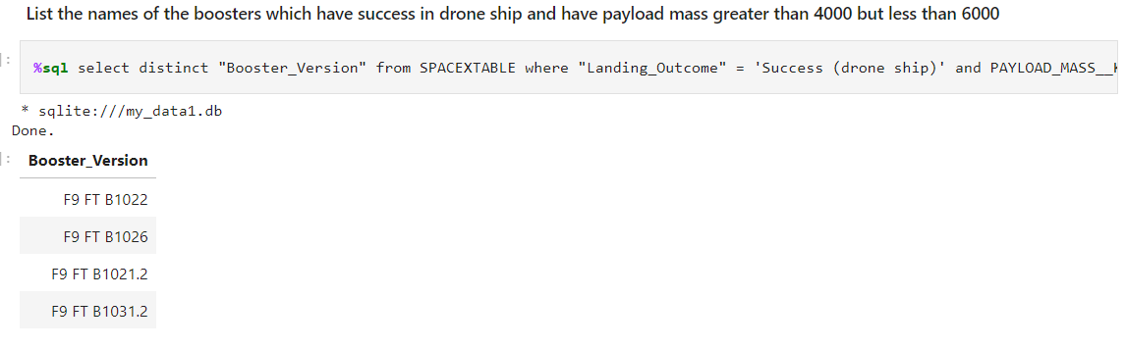
Successful Drone Ship Landing with Payload between 4000 and 6000
The following are the booter versions that have a payload between 4000 and 6000 kg which sucessfuly landed on a drone ship.

Slide 29
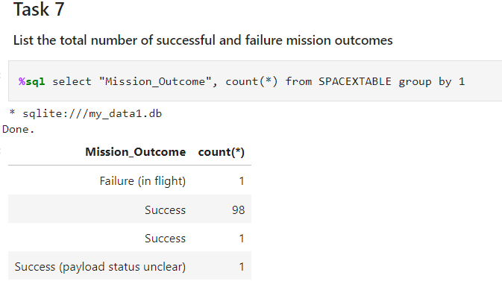
Total Number of Successful and Failure Mission Outcomes
There were 100 successful mission outcomes and 1 failure in flight.

Slide 30
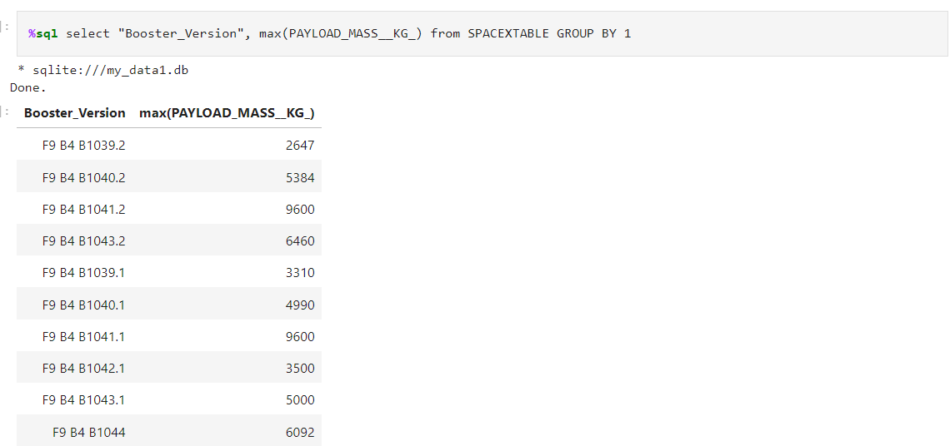
Boosters Carried Maximum Payload
Listed below there are the boosters that carried the maximum payload.

Slide 31
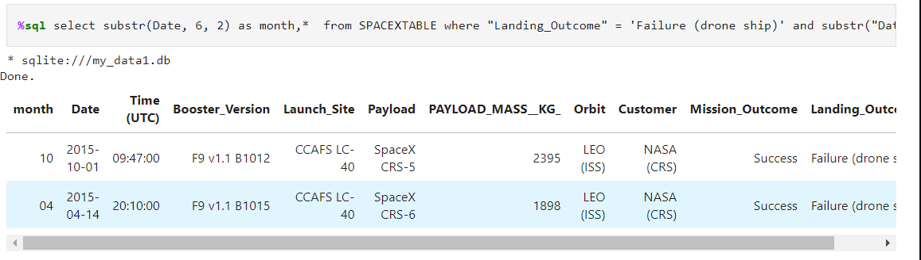
2015 Launch Records
Below is the list of failed landing_outcomes in drone ship, their booster versions, and launch site names for in year 2015.

Slide 32
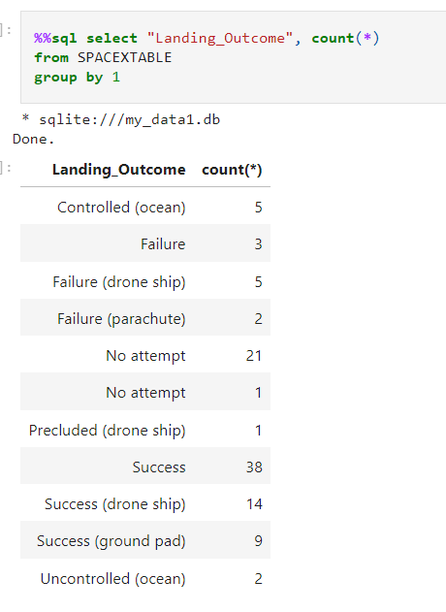
Rank Landing Outcomes Between 2010-06-04 and 2017-03-20
This is the ranking of landing outcomes (such as Failure (drone ship) or Success (ground pad)) between the date 2010-06-04 and 2017-03-20, in descending order

Slide 33

Section 3

Slide 34
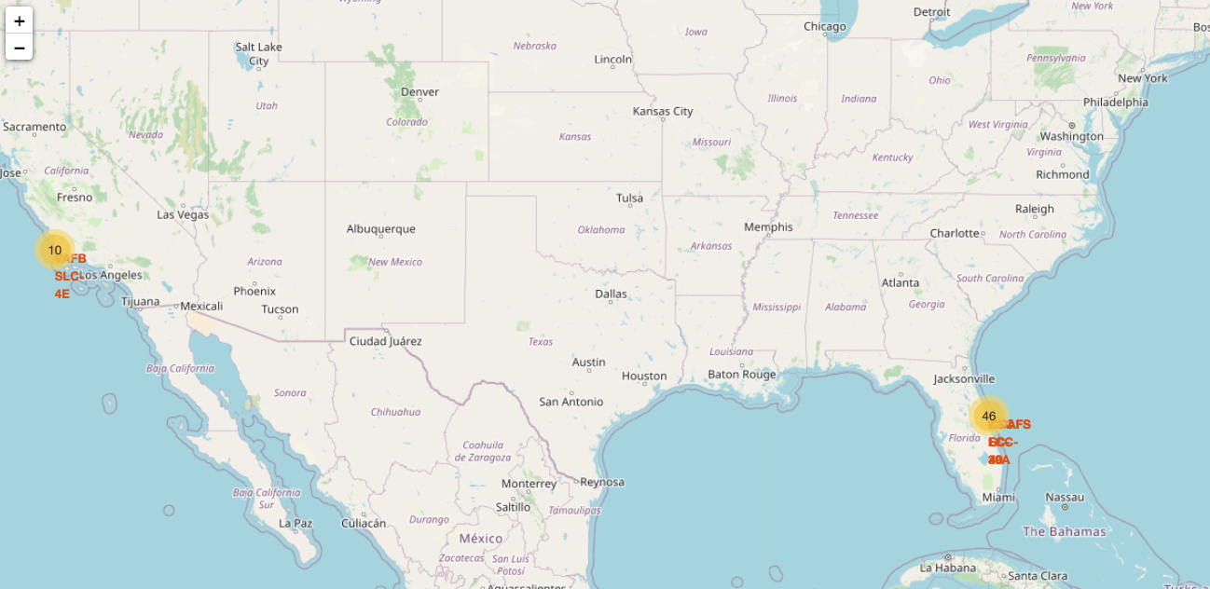
Launch Sites Location
These are all launch sites locations

Slide 35

Markers on one location

Slide 36

Distance between the sea and one location

Slide 37

Section 5

Slide 38
Classification Accuracy
The decision tree model has the highest accuracy using the method score, followed by the k nearest neighbors.

Slide 39
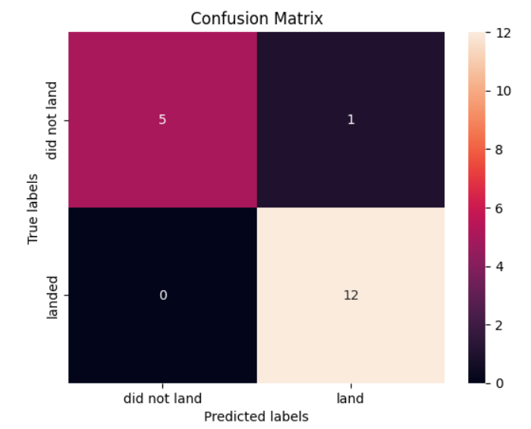
Confusion Matrix
In the confusion matrix of the decision tree model you can see that the model has only one false positive while the other models have 3.

Slide 40
Conclusions
Space X has improved through years the success rates of their launches.
ES-L1, GEO, HEO and SSO orbits has the highest success rate.
We can forecast new launches with our trained decision tree model having an accuracy of 95%.

Slide 41


